Slide 1

Annual Budget Trainings
Andrew Hinckley, Student Government Treasurer
Lisa Morris, Director of Finance, Budgeting, & Operations for Student Affairs
Stephanie O’Leary, FSC Operations & Budget Manager
Nicole Rigby, Assistant Director, CSLI
Miles Inman Vice-Chair of Ways & Means
Victoria Andrade-Fonseca, Vice President for Organizational Development

Slide 2
Acronyms and Definitions
WAM = Ways and Means
RAF = Request for Additional Funding
SIF = Student Involvement Fee
RSO = Recognized Student Organization
USG = University Student Government
FY = Fiscal Year
CSLI = Center for Student Leadership and Involvement
Annual Budget Hearings = Budgeting process for next Fiscal Year

Slide 3
What are we budgeting for?
FY 2023
  Fall 2022-Spring 2023 operating budget
  Main source of funds for the fiscal year
  NO Rollover option
    You may request the same amount of funding, but you will still need to attend a hearing

Slide 4
Timeline
December– Annual Budget Trainings
Now until January 15th, 2022– Annual Budget Request Submissions
January 15th, 2022 at Midnight– ANNUAL BUDGETS ARE DUE!
January 31st, 2022 10 AM-7 PM – Sign-ups for Annual Budget Hearings
February 3-5th, 10-12th,WAM Annual Budget Hearings (Bello 214)
February 16th, 2022 – Senate Appropriations Hearing (4pm Fisher Papitto)

Slide 5
WAM’s Philosophy
Ways and Means is charged with making fair and equitable allocations of SIF Dollars to enrich our campus
We fund approximately two-thirds of available funds to RSO during Annual Budgets
Be Creative! If an event is justified, WAM will fund it.
  Guidelines are for operational expenses not related to your RSO’s main purpose, don’t let them limit you

Slide 6
FY2023 Ways & Means Guidelines
Food for Internal Functions
  $20 per member*
Promotional Wearables
  $20 per member
Promotional Giveaways
  $400 per year*
Internal Awards for Members
  $200 per year
  *-Denotes change from FY2022
Printing & Copying
  $10 per year
Gifts for Lecturers
  $150 per year
University Event Participation
  $40 per event
Club Member Activity*
  $30 per member

Slide 7
What is Club Member Activity?
Any activity you wish to do as an organization that does not easily fall under a current guideline
Can be but not limited to: retreats, excursions, bonding events
Idea is for your group to get off-campus or together as a group to do something experiential and fun!
Can not be used for (even if it ties to a bonding event):
  More food
  More promotional material

Slide 8
Submitting an Annual Budget Request Walk-Thru
** Pretend everything says FY2023!! (these screenshots are old, but it is all the same except number and date changes)

Slide 9
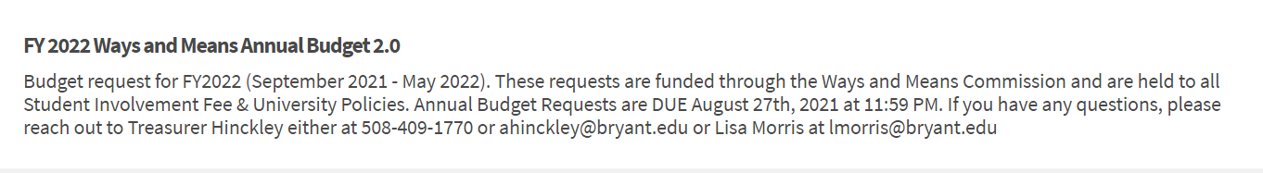
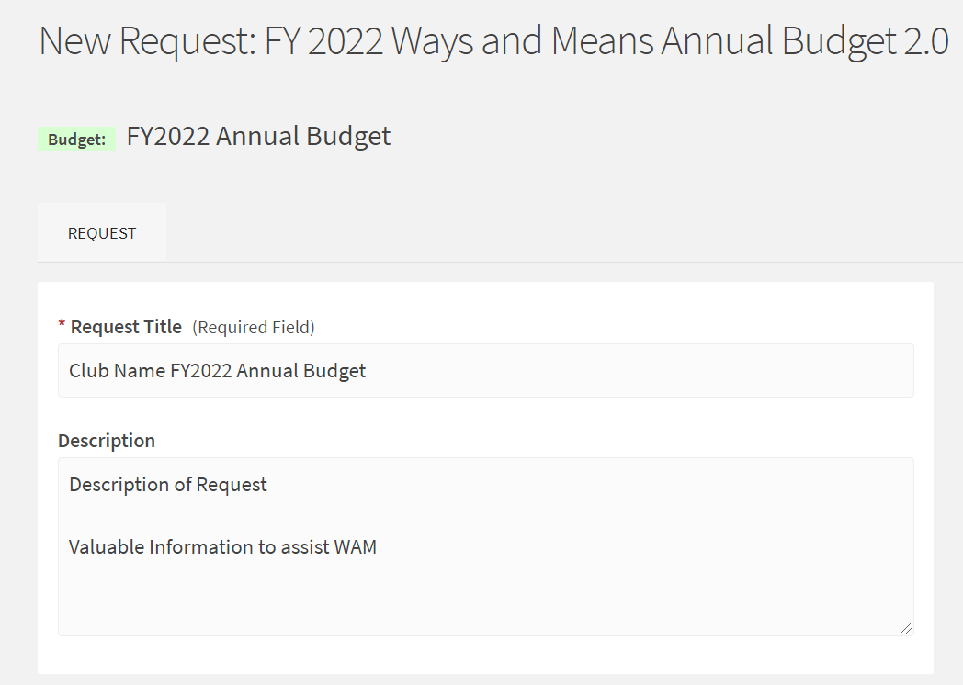
Select Budget Process: FY2023 Annual Budget
Give your request a title & brief description
The following page will provide important information about the Annual Budget Process

Slide 10
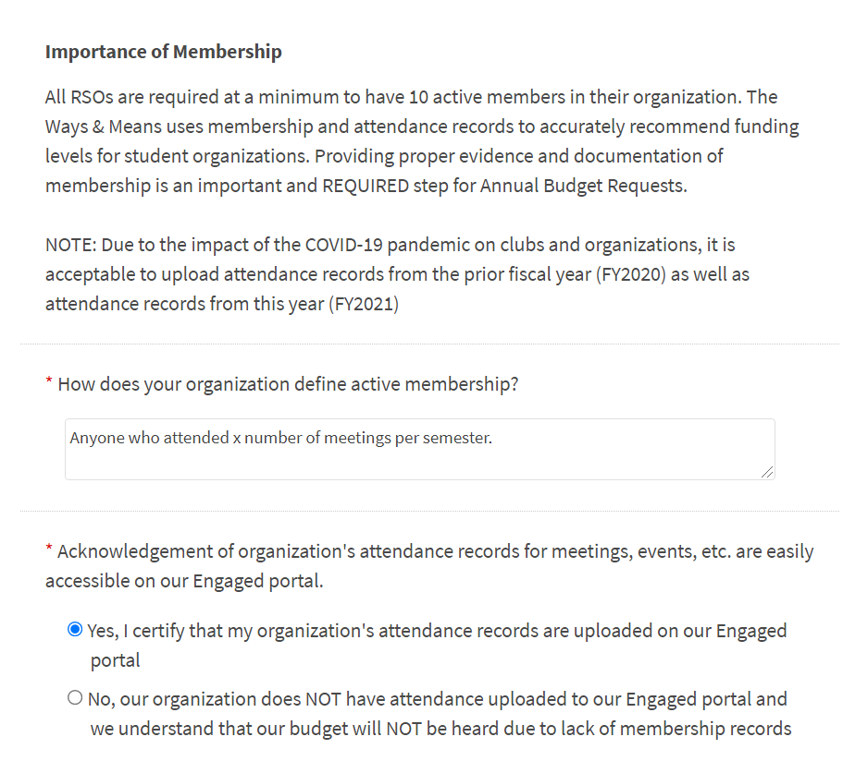
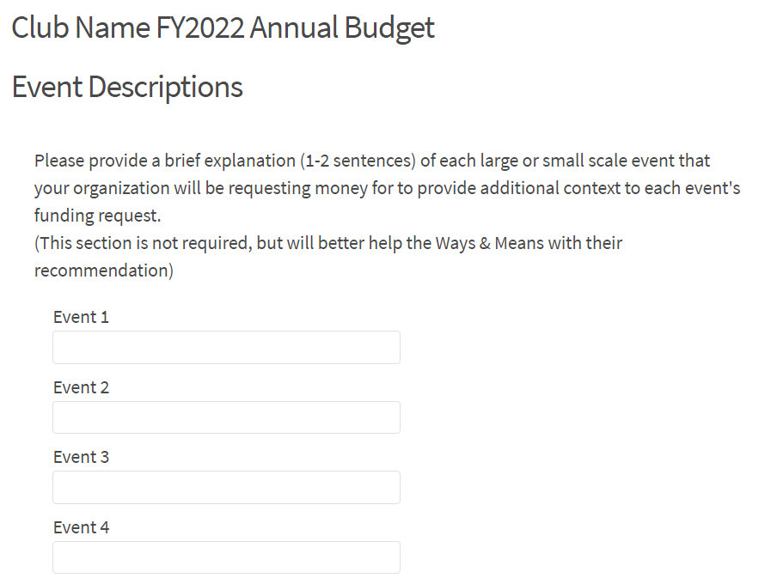
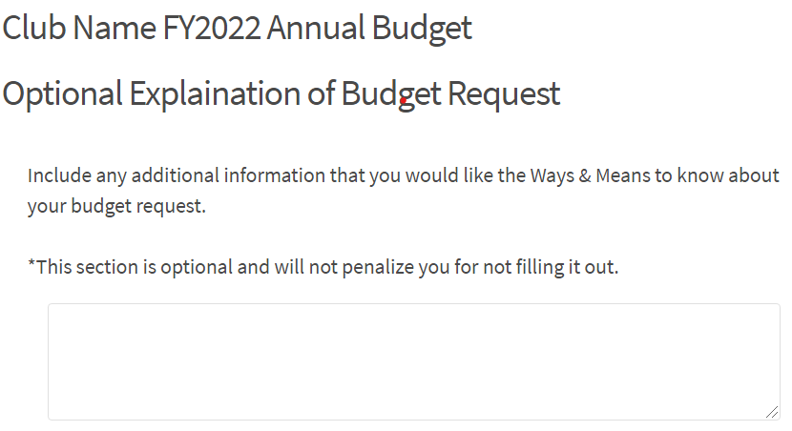
Define active membership & verify attendance is uploaded
Describe the events your organization plans on hosting
Provide any additional context

Slide 11
Notes
The next step will be to build your actual budget.
Please REVIEW all the available categories before adding line items.
  We broke out several commonly requested items into their own category to create an easier process on our end
Be mindful of the expense code that you are requesting from
When inputting the requested amount, if you are asking for something on a per member basis, do out the math in the equation so we can see the multiplication (example on the next few slides)
Remember to break up Promotional Wearables & Giveaways into separate categories
Read all the description throughout the request, there is information that will help you select the right options

Slide 12
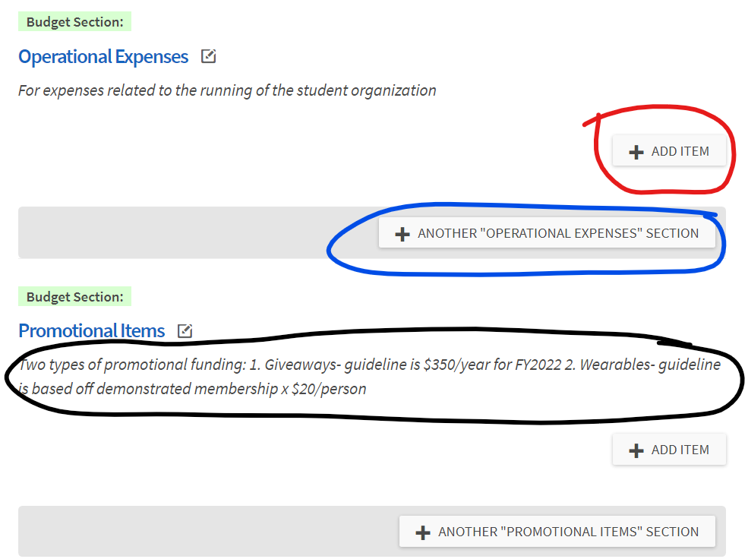
Use the “ADD ITEM” option to break out different line items throughout your request
Combine like line item (ex. Have 1 Misc. Supplies for all Misc. Supplies, do not have plates, decoration, etc. as their own line item if for the same event/purpose
Use “+ANOTHER “XXX XXXX” SECTION” to break out separate event, activities, etc.
Please read the descriptions to familiarize yourself with what expenses are supposed to be listed here
Also find WAM FY2023 Guidelines here

Slide 13
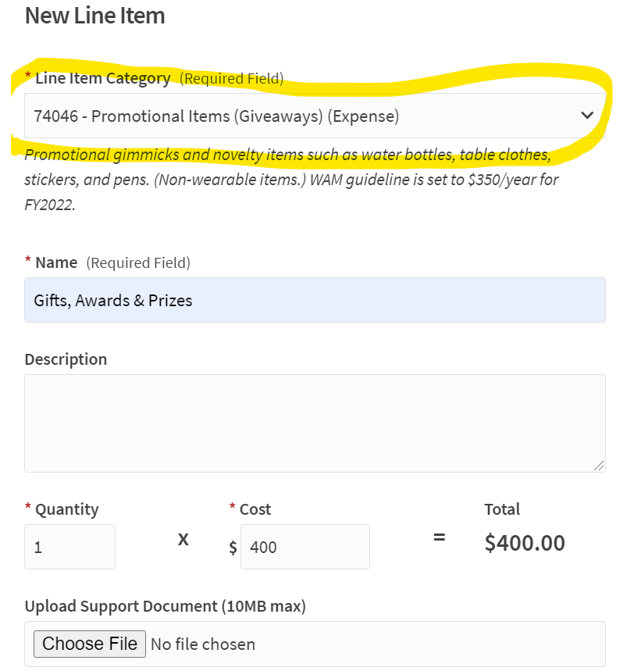
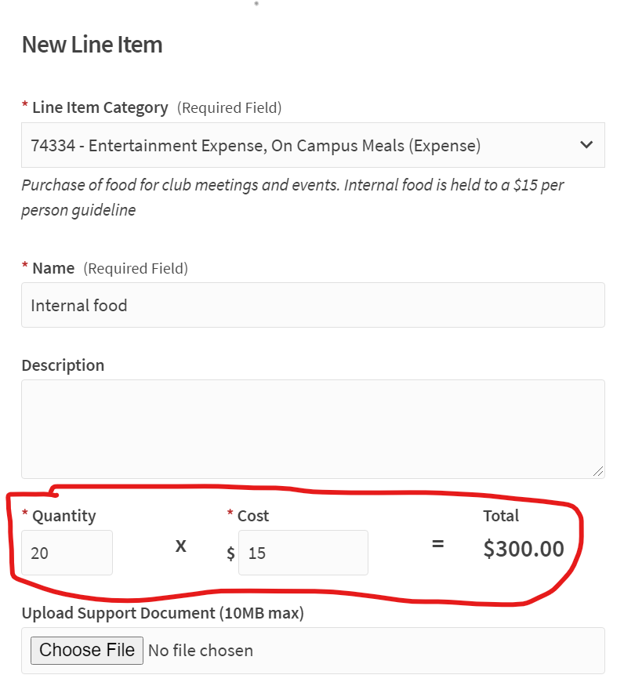
Remember to select the proper Expense Code (This request should be selected as “74334 – Entertainment Expenses, On Campus Meals (Expense)” This it the expense code for all food line items)
Please also break out request with Quantity as number of members and cost as the per member price

Slide 14
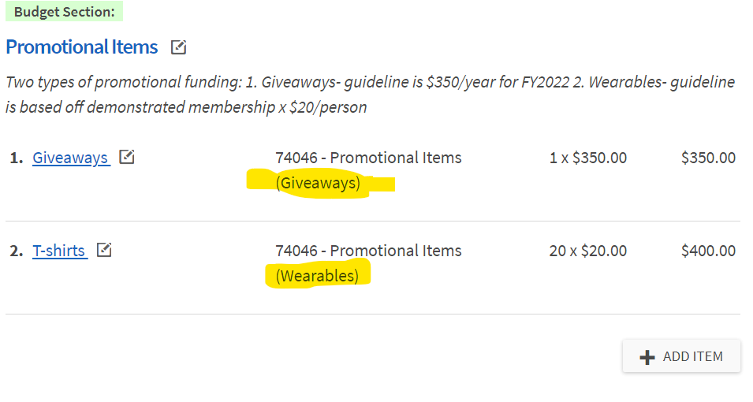
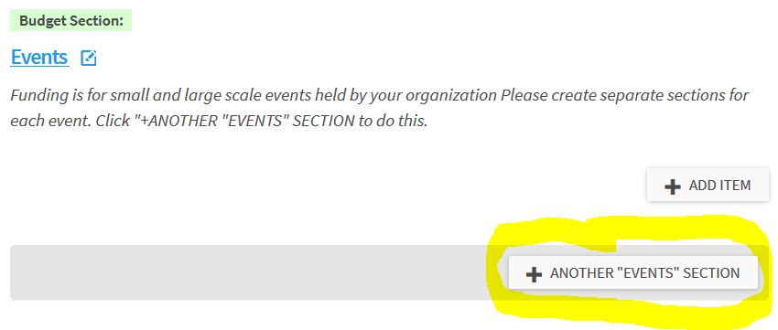
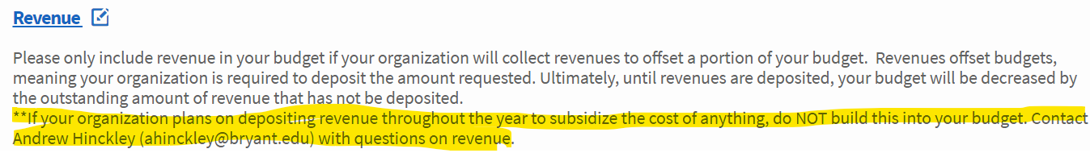
Remember to separate Promo Giveaways & Wearables
Please separate EACH event into its own section by using “+ANOTHER “EVENTS” SECTION”
  Do for both small- and large-scale events
Revenue should only be included is your organization will collect revenues to offset a portion of your budget.

Slide 15
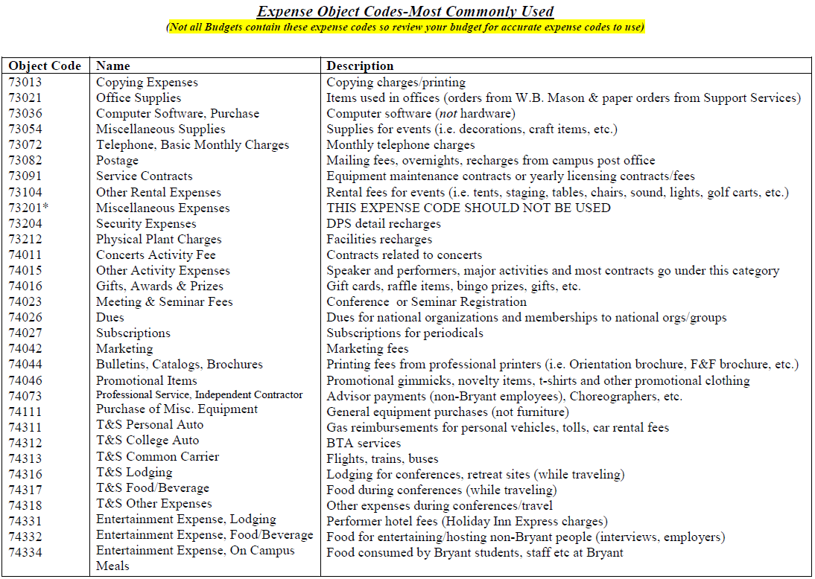
Expense Codes
PDF on Engaged (Student Government & WAM Portal)
Note: Request with multiple egregious expense code errors may be rejected by WAM

Slide 16
Annual Budget Policies
Budget request not submitted before deadline (January 15th, 2021 @ Midnight) will be Denied
If Treasurer does not attend Annual Budget Training, the request will be Denied
Overnight & Day Travel will NOT be funded during Annual Budget Hearings
  All travel request will be made during RAF season in fall/spring (The week after these hearings)
Organizations with low dollar amount Annual Budgets Request may not need to attend a WAM hearing
  Organizations exempt from hearings will be notified after all request have been submitted and applies to organizations that request almost entirely guideline items.
  Optional privilege, will still be allowed to have a hearing if requested
All request must be in whole dollar amounts
ONLY the Treasurer can submit an Annual Budget Request

Slide 17
Annual Budget Policies - Attendance
Please reach out to Nicole Rigby for your attendance
  Organizations should be using CORQ to track attendance
  If you have no CORQ data, you must provide and upload an alternate tracking document, or you will not receive any funding
  If your alternate tracking document conflicts with your CORQ data, be prepared to explain why
    WAM will be looking more at the CORQ attendance rather than alternate documents, as all attendance should have been on CORQ this year
  Be prepared to discuss the success and challenges of recurring events that you are requesting funds for
EVIDENCE OF MEMBERSHIP IS REQUIRED.
Organization need to demonstrate 10+ active members in order to receive any funding
Contact Nicole Rigby, Luke Lamontagne, or Victoria Andrade-Fonseca with any questions regarding membership
Notes:
Nicole, Victoria and I have added a minimum for membership, so groups can make membership more difficult but they should at least adhere to the minimum which is 3 meetings per semester.

Slide 18
Next Steps
Upload Membership
Submit Annual Budget Request before 1/15/2022 Midnight deadline
Sign-up for a hearing time (if applicable) on 1/31/22 from 10am to 7pm in the Senate Office—Third floor of Fisher
  Organizations with large requests may be scheduled by me during the 2-4 PM time we usually have in Bello 214 on Wednesdays (you will hear from me on this)
Attend WAM Hearing (if applicable)
Attend Senate Appropriation Hearing (2/16/22 @ 4pm in Bello Grand Hall)
  All RSOs requesting an Annual Budget must attend
  Any appeals will be heard on either 2/16 or 2/23

Slide 19
Summary
Do not request any travel funding
Check out new FY2023 Guidelines
All documents posted to RSO Treasurer Files and Resources Folder on the Ways & Means portal
Reach out with any questions

Slide 20
Treasurer Updates/Reminders
Moving forward…
  All communication on Budget Requests will be done on Engaged
  Please check the comment section
On a rolling basis, Membership will be verified on Engaged
  There will be a comment on the request listing the number of active members
RAFs will not be heard until AFTER Annual Budget Hearings are completed
Some important other updates
  Please return itemized receipts upon returning the P-card
  Keep copies of your receipts!! (especially if you know you will have shipping issues or delayed delivery)
  All RAFs should be in and complete
  The last day to use any SIF funds is the last day of classes. If you need to spend at all over winter Break you must reach out to Lisa Morris and there must be a significant need to spend
  Optional next semester training
Notes:
Updates on hearing times, decreases in line items, etc.
Next WAM: 2/12/2019
We will not be emailing organizations about WAM recommendation
You have access to the information, if you want, look for it ☺

Slide 21
Contact Information
Andrew Hinckley, Student Government Treasurer
  ahinckley@bryant.edu
  508-409-1770
Lisa Morris, Associate Director of Financial Services & Operations
  lmorris@bryant.edu
Stephanie O’Leary, Student Center Operations & Budget Manager
  Soleary8@bryant.edu
Nicole Rigby, Assistant Director for CSLI
  Nrigby@bryant.edu
Victoria Andrade-Fonseca, Vice President for Organizational Development
  vandradefonseca@bryant.edu
Luke Lamontagne, Vice President for Student Organizations
  llamontagne1@bryant.edu

Slide 22
QUESTIONS?

